Slide 1
Hacer una presentación
By CJ Conti

Slide 2
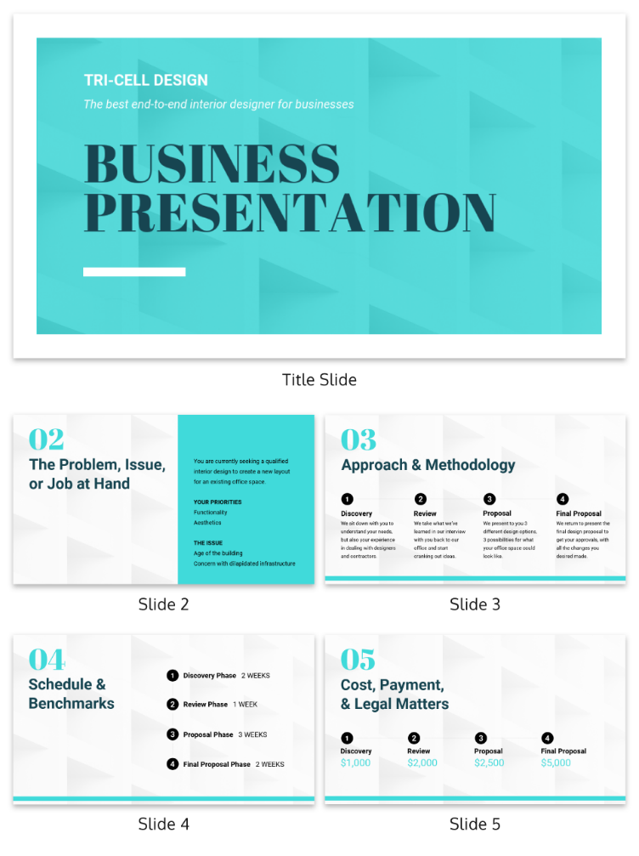
What is a PowerPoint Presentation
Series of slides
Text images and videos
“Convey a message or story”
Always refer back to message/story

Slide 3

What are different types of presentations?
Informative
Instructive
Persuasive
Decision Making
Progress
Picture

Slide 4
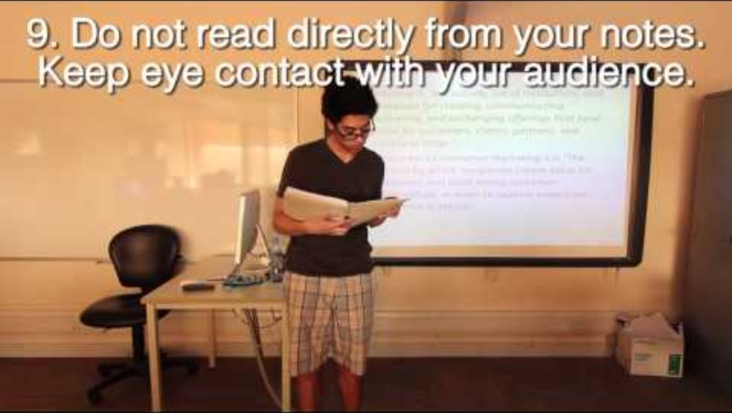
Presentation Good/Bad Examples
https://youtu.be/S5c1susCPAE

Slide 5
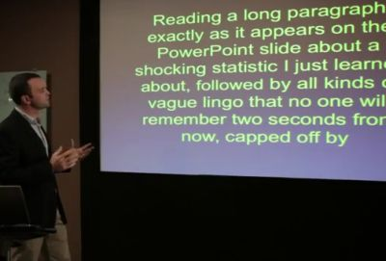
What are some things to avoid in a presentation?
Forgetting about the audience.
Word for word
Too busy presentation
Presenting without practicing
Panicking due to surprises
Picture

Slide 6
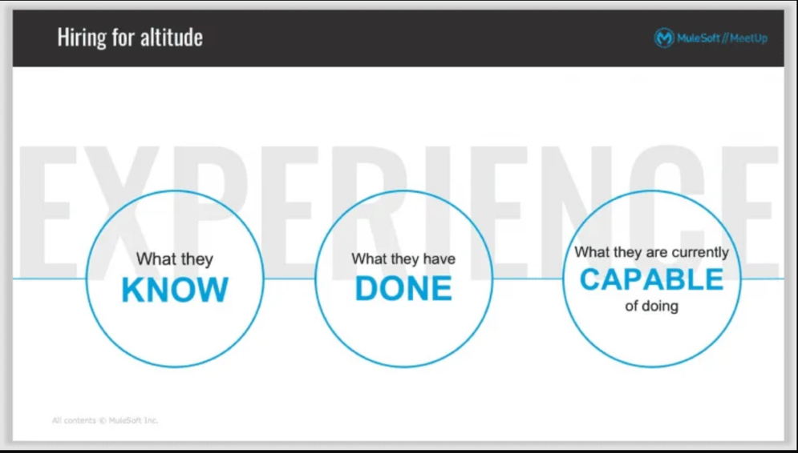
What are some ways of improving a PowerPoint presentation?
Simple slides
Minimal Effects
Lists instead of lines
Phrases over sentences
One idea per slide
Picture

Slide 7

How do you best deliver a presentation?
Opening hook
Project clearly
Pause to regain focus
Emotion and varied tone
Eye contact
Picture

Slide 8

Questions
Picture

Slide 9
References
https://support.microsoft.com/en-us/office/basic-tasks-for-creating-a-powerpoint-presentation-efbbc1cd-c5f1-4264-b48e-c8a7b0334e36
https://www.beautiful.ai/blog/6-different-types-of-presentations
https://outu.be/S5c1susCPAE
https://www.glassdoor.com/blog/presentation-mistakes/
https://slidepeak.com/blog/50-tips-on-how-to-improve-powerpoint-presentations-in-2021
https://www.petersons.com/blog/11-tips-for-delivering-an-effective-presentation/
https://venngage-wordpress.s3.amazonaws.com/uploads/2019/02/template-texture.png
https://about.imginators.com/wp-content/uploads/2018/06/introduction-to-business-presentation.png
https://s39939.pcdn.co/wp-content/uploads/2017/06/Bad_Powerpoint_Slide-1.jpg
https://adriennejohnston.com/wp-content/webpc-passthru.php?src=https://adriennejohnston.com/wp-content/uploads/2019/08/PowerPoint-Expert-Tips-no-bullets-768x435.png&nocache=1
https://simplyamazingtraining.co.uk/wp-content/uploads/2020/01/dont-forget-to-breath-banner-resized-1-730x411.png
https://virtualspeech.com/img/blog/header/importance_eye_contact_presentation.jpg

